Slide 1
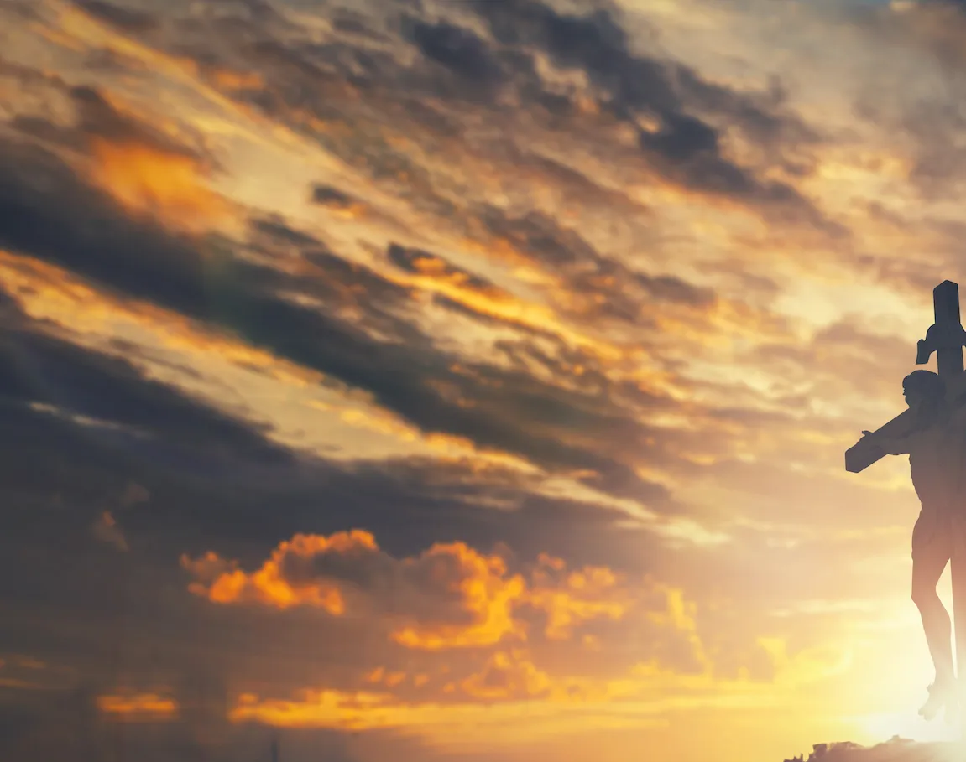
In Christ Alone

Slide 2
CAPO at 2nd (D)
F C Am G
In Christ alone my hope is found
C F G C
He is my light, my strength, my song
F C Am G
This cornerstone, this solid ground
C F G C
Firm through the fiercest drought and storm

Slide 3
C F Am G
What heights of love, what depths of peace
C F Am G
When fears are stilled, when strivings cease
F C Am G
My comforter, my all in all
C F G C C
Here in the love of Christ I stand

Slide 4
F C Am G
In Christ alone, who took on flesh
C F G C
Fullness of God in helpless babe
F C Am G
This gift of love and righteousness
C F G C
Scorned by the ones He came to save

Slide 5
C F Am G
'Til on that cross as Jesus died
C F Am G
The wrath of God was satisfied
F C Am G
For every sin on Him was laid
C F G C C
Here in the death of Christ I live

Slide 6
F C Am G
There in the ground His body lay
C F G C
Light of the world by darkness slain
F C Am G
Then bursting forth in glorious day
C F G C
Up from the grave He rose again

Slide 7
C F Am G
And as He stands in vict-ory
C F Am G
Sin's curse has lost its grip on me
F C F G
For I am His and He is mine
C F G C C
Bought with the precious blood of Christ

Slide 8
F C Am G
No guilt of life, no fear in death
C F G C
This is the power of Christ in me
F C. Am G
From life's first cry to final breath
C F G C
Jesus commands my destiny

Slide 9
C F Am G
No power of hell, no scheme of man
C F Am G
Can ever pluck me from His hand
F C Am G
'Til He returns or calls me home
C F G C
Here in the power of Christ I'll stand
X2 & END

Slide 10
How Great is Our God

Slide 11
G Em
The splendor of the King Clothed in majesty
C
Let all the earth rejoice All the earth rejoice
G Em
He wraps Himself in light And darkness tries to hide
C
And trembles at his voice Trembles at his voice

Slide 12
G
How great is our God, sing with me
Em
How great is our God, all will see
C D G
How great, how great is our God

Slide 13
G Em
Age to age He stands And time is in His hands
C
Beginning and the end Beginning and the end
G Em
The Godhead, three in one Father, Spirit, Son
C
The Lion and the Lamb The Lion and the Lamb

Slide 14
G
How great is our God, sing with me
Em
How great is our God, all will see
C D G
How great, how great is our God

Slide 15
G
Name above all names
Em
Worthy of all praise
C
My heart will sing
D G
How great is our God
x2 & chorus

Slide 16
G
How great is our God, sing with me
Em
How great is our God, all will see
C D G
How great, how great is our God
x2 End

Slide 17
Only A Holy God

Slide 18
Am / C / F / C CAPO 2nd for Marina, Skyler
Am C F C
Who else commands all the hosts of heaven
Am C F C
Who else could make every king bow down
Am C F C
Who else can whisper and darkness trembles
F G C
Only a Holy God

Slide 19
Am C F C
What other beauty demands such praises
Am C F C
What other splendour outshines the sun
Am C F C
What other majesty rules with justice
F G C
Only a Holy God

Slide 20
Am F
Come and behold Him
C G
The One and the Only
Am F
Cry out, sing holy
C G Am
Forever a Holy God
F G
Come and worship the Holy God

Slide 21
Am C F C
What other glory consumes like fire
Am C F C
What other power can raise the dead
Am C F C
What other name remains undefeated
F G C
Only a Holy God

Slide 22
Am F
Come and behold Him
C G
The One and the Only
Am F
Cry out, sing holy
C G Am
Forever a Holy God
F G
Come and worship the Holy God
x2

Slide 23
Am C F C
Who else could rescue me from my failing
Am C F C
Who else would offer His only Son
Am C F C
Who else invites me to call Him Father
F G C
Only a Holy God

Slide 24
Am F
Come and behold Him
C G
The One and the Only
Am F
Cry out, sing holy
C G Am
Forever a Holy God
F G
Come and worship the Holy God
END

Slide 25
In Jesus Name (God of Possible)

Slide 26
Bm G
I speak the name of Jesus over you
D A
In your hurting, in your sorrow, I will ask my God to move
Bm G
I speak the name 'cause it's all that I can do
D A
In desperation I'll seek heaven and pray this for you
CAPO @ 3rd (F)

Slide 27
Bm G
I pray for your healing, that circumstances would change
D A
I pray that the fear inside would flee in Jesus name
Bm D
I pray that a breakthrough would happen today
D A
I pray miracles over your life in Jesus name
Bm D G
In Jesus name
To verse 2

Slide 28
Bm G
I speak the name of all authority
D A
Declaring blessings, ev'ry promise He is faithful to keep
Bm G
I speak the name no grave could ever hold
D A
He is greater, He is stronger, He's the God of possible
To Chorus

Slide 29
Bm G
I pray for your healing, that circumstances would change
D A
I pray that the fear inside would flee in Jesus name
Bm D
I pray that a breakthrough would happen today
D A
I pray miracles over your life in Jesus name
Bm G
In Jesus name
To Bridge

Slide 30
Em G
Come believe it, come receive it
D Asus A
Oh, the power of His Spirit is now forever yours
Em G
Come believe it, come receive it
D Asus A
In the mighty name of Jesus, all things are possible
To Chorus

Slide 31
Bm G
I pray for your healing, that circumstances would change
D A
I pray that the fear inside would flee in Jesus name
Bm D
I pray that a breakthrough would happen today
D A
I pray miracles over your life in Jesus name

Slide 32
Bm G
I pray for revival, for restoration of faith
D
I pray that the dead will come alive
Asus A Bm
In Jesus name, in Jesus name
Bm / G / D / A
END

Slide 33
Turn Your Eyes Upon Jesus

Slide 34
G / Bm / C / D
G Bm
O soul are you weary and troubled
C G
No light in the darkness you see
G Bm
There's light for a look at the Savior
C D G
And life more abundant and free

Slide 35
G D Em D
Turn your eyes upon Jesus
C Em D
Look full in His wonderful face
G Bm
And the things of earth
Em G
Will grow strangely dim
G D G
In the light of His glory and grace

Slide 36
G Bm
Through death into life everlasting
C G
He passed and we follow Him there
G Bm
O’er us sin no more hath dominion
C G
For more than conquerors we are

Slide 37
G D Em D
Turn your eyes upon Jesus
C Em D
Look full in His wonderful face
G Bm
And the things of earth
Em G
Will grow strangely dim
G D G
In the light of His glory and grace

